Slide 1
Spotify Sequential Skip Prediction
By: Nihar Shah

Slide 2


Definition
This is a random user
No Skip
Given a song
Start
End
Spotify wants to know if the user will skip the song or not, if yes then after how long will they skip it. The song is divided into 3 parts as shown above. They have labeled them as skip1 skip2 and skip3 in the data, where skip1 indicates that a person will skip a song before 1/3rd of the song is played.

Slide 3
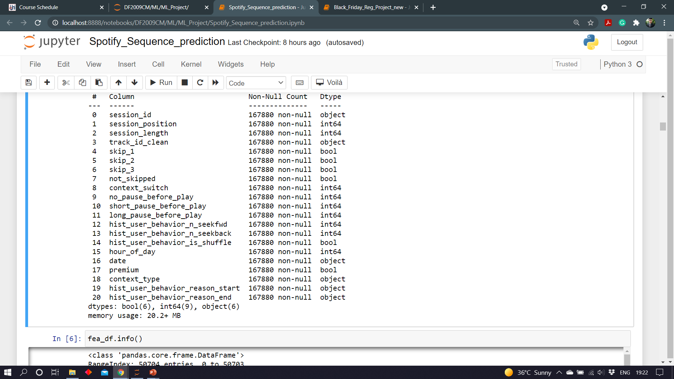
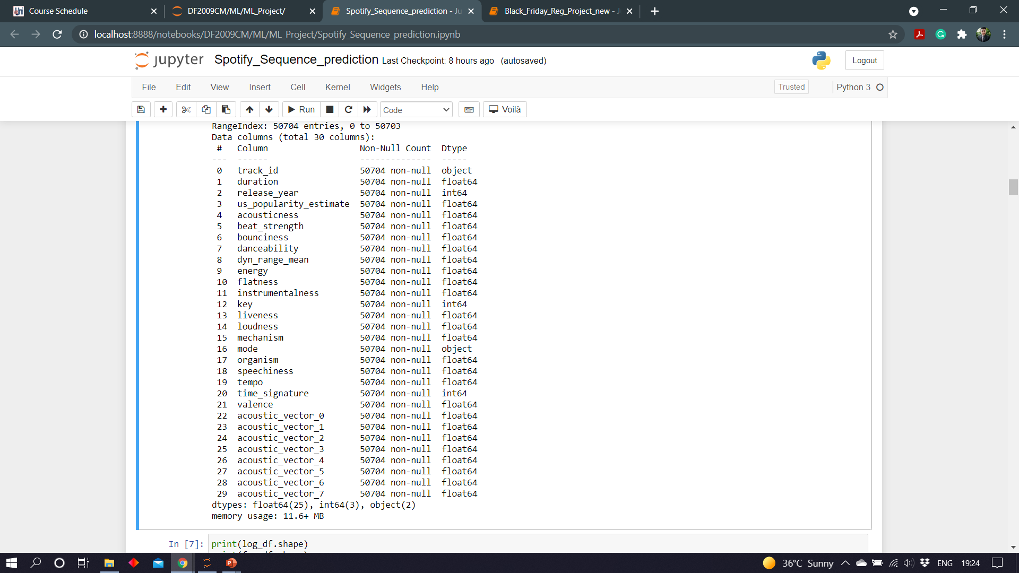
Features in the data
Table 1(user log)
Table 2 (song data)

Slide 4
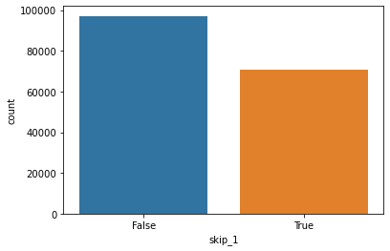
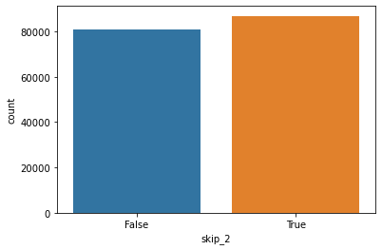
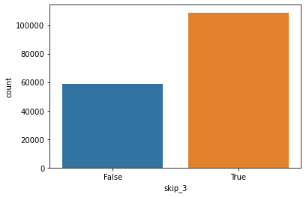
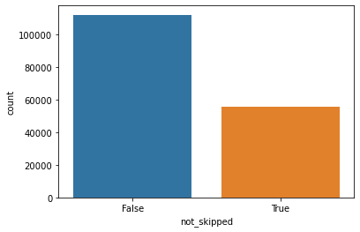
Understanding the data
167880 Total Records

Slide 5
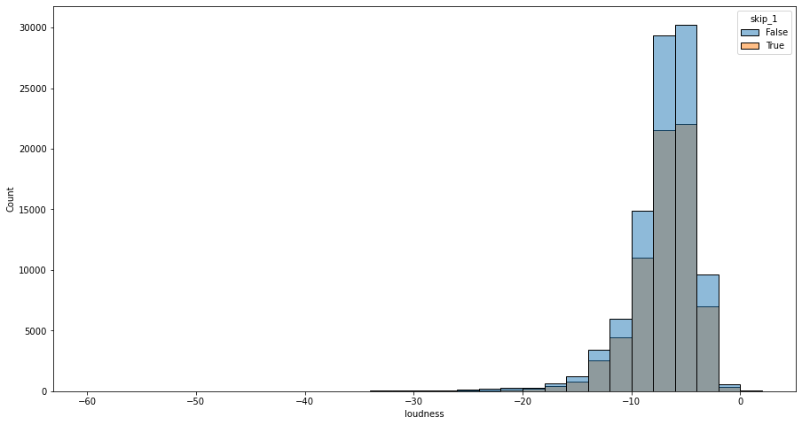
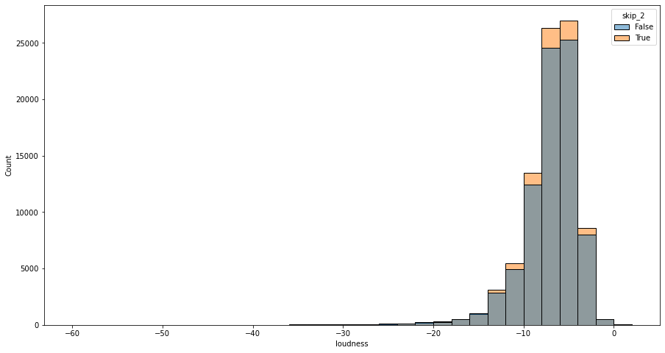
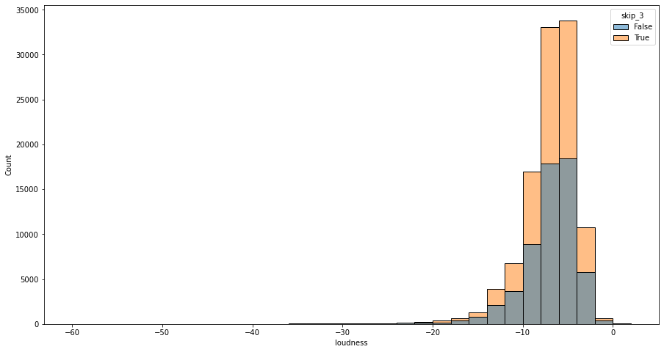
Can loudness of song impact the skip?
Songs are being skipped in phase 2 and 3 more. But the count of skips is normally distributed over loudness

Slide 6
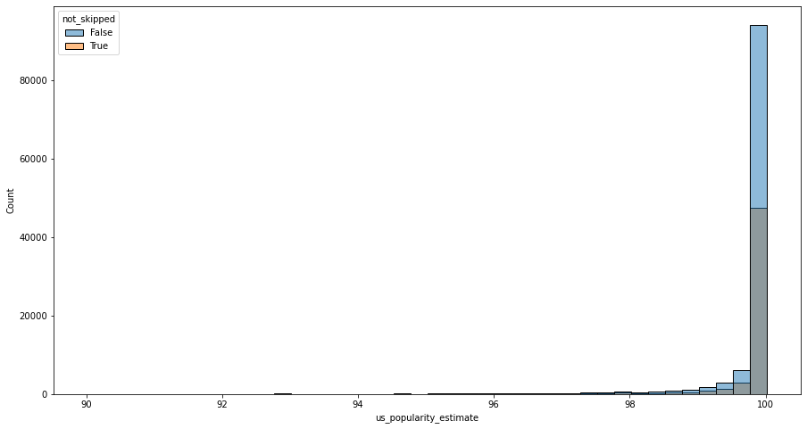
Can the popularity of song impact skip?
Seems like more the song’s popularity More are they being skipped. But on the other hand, in each bin around 50% of the songs are being skipped.

Slide 7
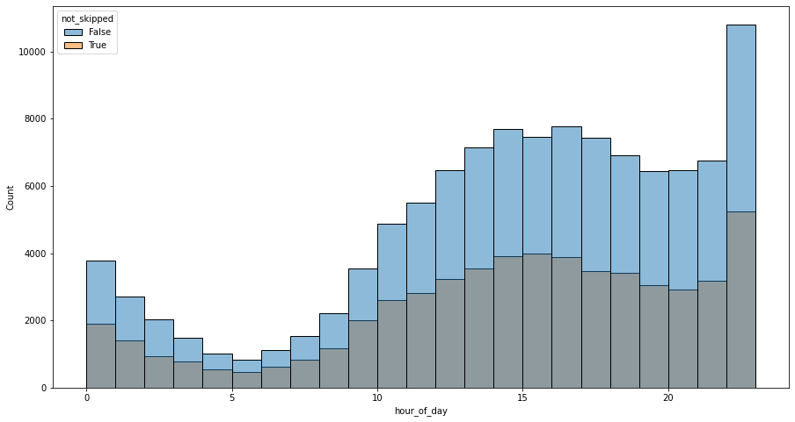
Can the hour of day impact Skip?
Time slot of 22-midnight registers the maximum song requests. But overall proportion of skips remains around that 50% mark.

Slide 8
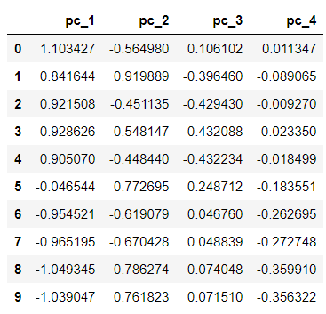
Scaling & PCA
Understanding the impact of 70 features is very difficult.
Transformed those 70 features into 4 principle components.
The variability explained by those components is around 0.98389601≈ 98%
In addition as the data is skewed, we have applied min-max scaler to scale the data

Slide 9
Balanced scorecard slide 5
Model SCORECARD
Explanibility of
the model
Execution Time of
The model
Practicality of
implementing
the model
Accuracy
0.8049
Logistic Regression
0.8054
KNN
0.9274
Random Forest
0.6380
SVM

Slide 10
Thank you

